Slide 1


Robotic Arm
Submitted to :-
Prof. Abdel Latif Elshafie
Ahmed Elsayed Ragab Sec: 1 BN: 4
Abd Elrahman Elsayed Abdo Sec: 2 BN:30
Mario Magdy Wageh Sec: 3 BN:16
Mohamed Ragab Fergany Sec: 3 BN: 30
Mahmoud Ahmed Abdelghany Sec: 4 BN: 8

Slide 2
Contents
Introduction
Design Process
Mechanical Design
Electrical design
Control method
Graphical User Interface (GUI)

Slide 3
Introduction
This project is one of the most important automatic control projects, especially in the field of industry, as the automatic arm is located in most factories, which facilitates the control process and increases productivity.

Slide 4
Design Process
In this project there are 3 degrees of freedom, so if we want to move to a point in the vacuum then we must use 3 motors to achieve this point in addition to a fourth motor to control the gripper.

Slide 5
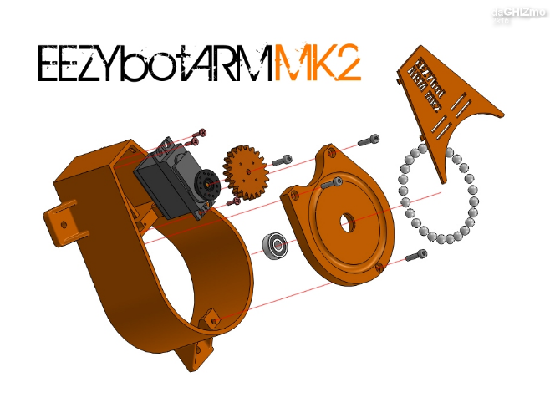
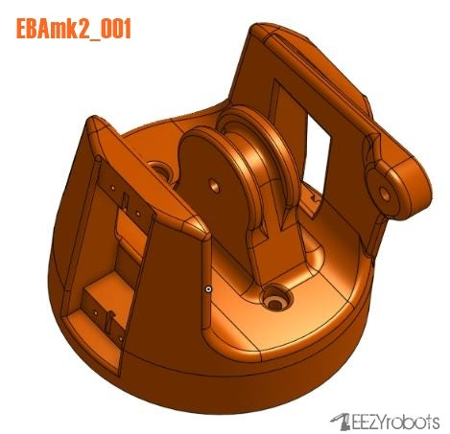
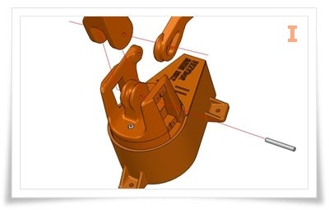
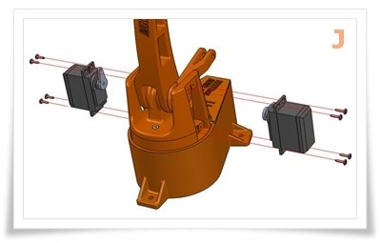
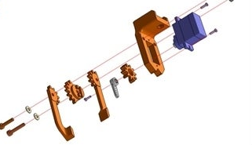
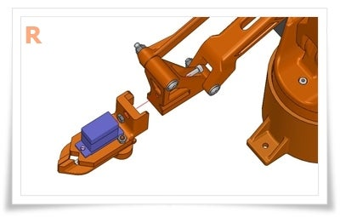

Mechanical Design
This design consists of three main parts:-
1- The main base
2-The main arms
3-The gripper

Slide 6
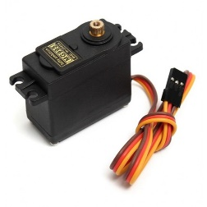
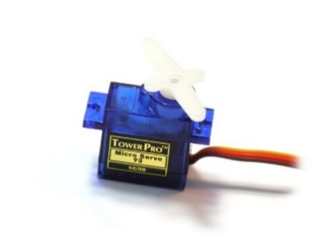
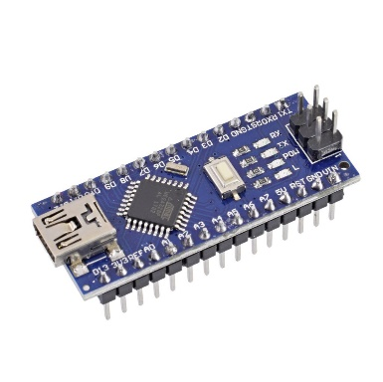
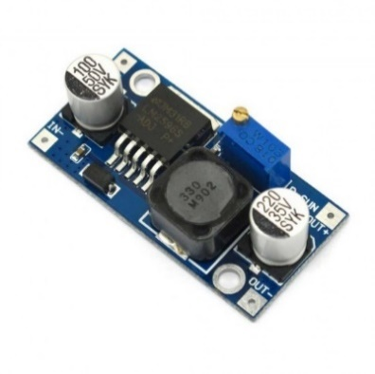
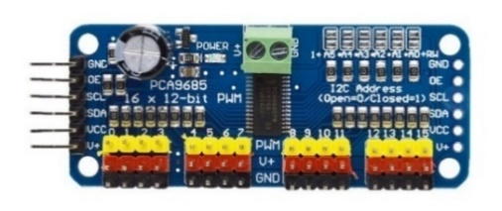
Electrical design
1) 3 Servo motors High Tor500mA-900mAque 180 degrees (90in each direction).
2) 1 servo motor low torque 180 degrees (90in each direction).
3) Arduino nano
4) Step down converter(3A)
5) PCA9586

Slide 7
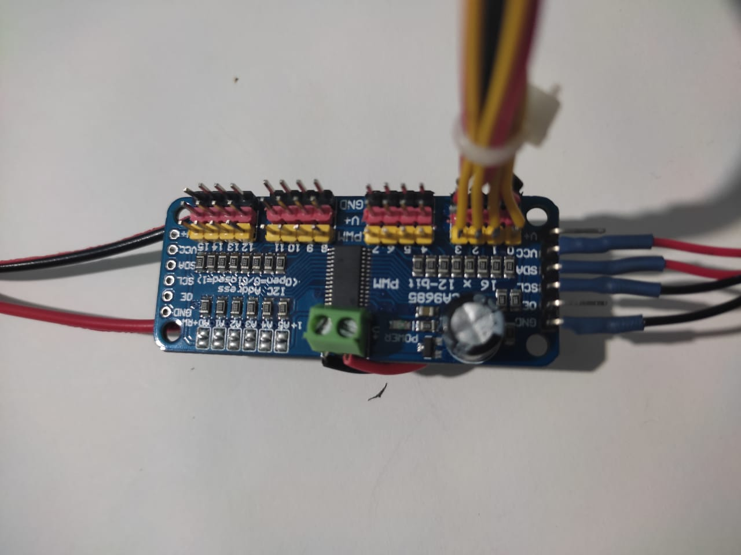
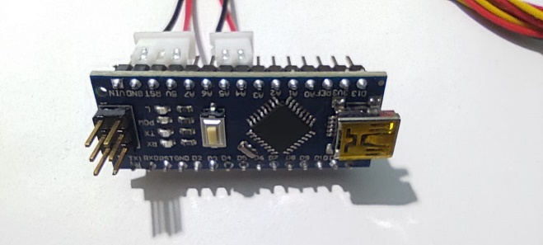



Electrical connection
We have two main parts:
Servo Motor Driver + DC-DC converter (Part1)
Arduino nano (Part2)
In this part there is four 3 pin connectors for the motors and they numbered from 0 to 3, and we have two connectors for Arduino one for the power (A) and the other for $I^{2}C$ communication (B), and the last one is a 12 volts DC power jack.
In this part there is two connectors from part1 one for power and the other for the $I^{2}C$ communication and we have one (USB-micro USB) to connect the Arduino to the laptop.
power
$I^{2}C$

Slide 8
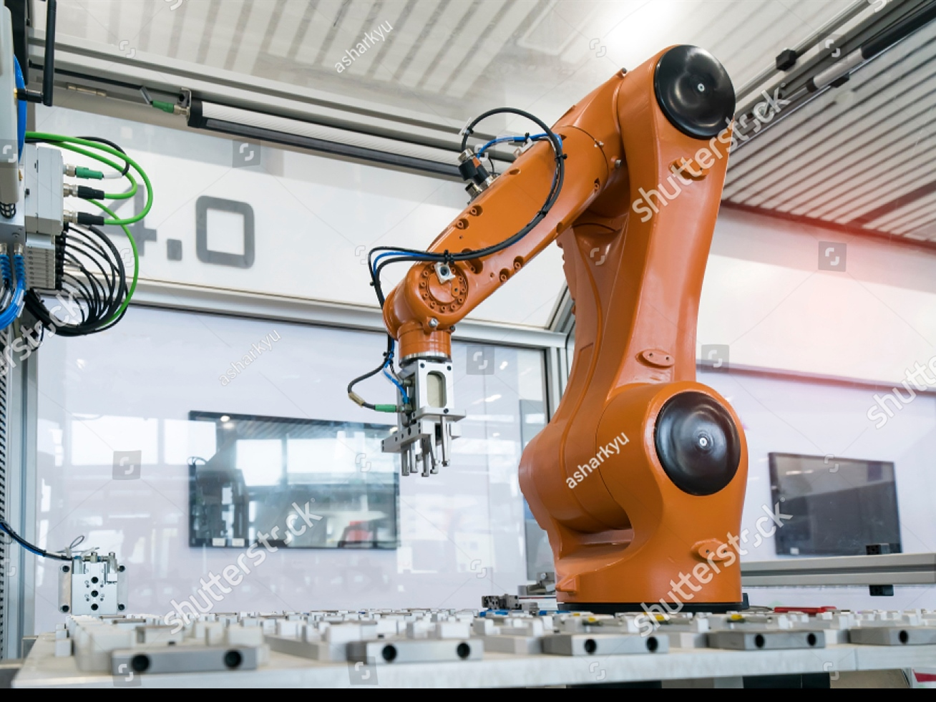

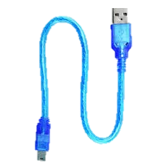
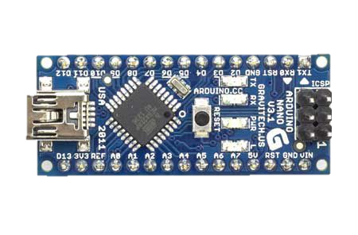
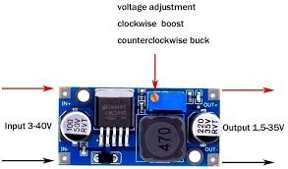

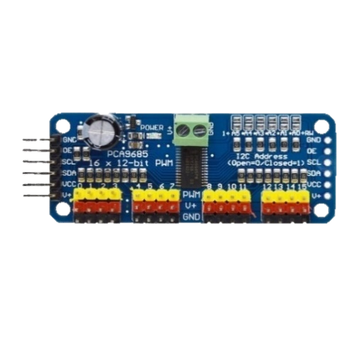
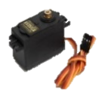
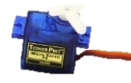

Slide 9

Control method
The objective is to achieve a point in a 3d space we will do that by controlling the position of the three main motors as following :-
Base Motor (90 degrees corresponding to motion in XY plan)
Right Arm Motor (63 degrees corresponding to motion in ZX plan)
Left Arm Motor (81 degrees corresponding to motion in YZ direction)
Due to mechanical constrains of the Robotic Arm design the right & left motors are calibrated to their optimum angle values which are 63 degrees and 81 degrees respectively.
The relation between PWM and Degrees Mapping :-
These motors are running at PWM signal with duty cycle (2-12.5%) at frequency 50 Hz so, if we want to achieve a mechanical degree, we can use this relation:
$$θ_{mech}= \frac{1800}{97} δ_{\%}− \frac{4500}{97}$$

Slide 10
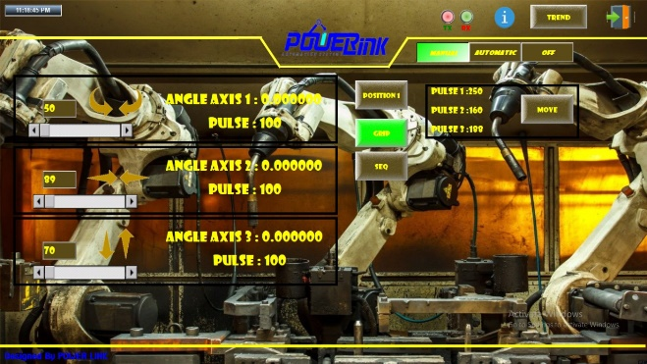
Graphical User Interface (GUI)
This GUI is designed with InduSoft web studio, all motion control signals come from the GUI (Desktop Application) through MODBUS RTU communication protocol.
In this program we have a communication sheet which includes the addresses of the required registers to be accessed on the microcontroller also we specify the required communication process (Writing & Reading).
The symbols that used in GUI :-
Three slide bars each one control an axis of the robot.
( Textbox + Arrows ) to control the robot axes step by step.
Grip button to open and close the robot gripper.
SEQ button to perform the pre-programed sequence of motion which written in the Arduino program.

Slide 11
Robotic Arm Operating Modes
There are 4 modes of operation :-
Continuous mode using slide bar .
Step mode using ( textbox + Arrow ) .
Move mode .
Pre-programmed sequence .

Slide 12


